Slide 1

PROJECT TITLE
IoT BASED PUSH-UP COUNTER
USING RASPBERRY PI
PROJECT BATCH : B-17
PROJECT MEMBERS : PROJECT GUIDE :
P. PREM JAYAPAUL(21BQ1A04A1) DR. P. AMMI REDDY
K. SIVA SAI KOTI REDDY(21BQ1A0459) PROFESSOR,ECE Department BHAVANNARAYANA (22BQ5A0428)
N. KIRAN KUMAR(21BQ1A0486)

Slide 2
TABLE OF CONTENTS :
INTRODUCTION
ABSTRACT
COMPONENTS USED
BLOCK DIAGRAM
FLOW CHART
OPERATION
ADVANTAGES & DISADVANTAGES
CONCLUSION

Slide 3
INTRODUCTION
An IoT-based Push-Up Counter using Raspberry Pi offers an innovative approach to fitness tracking by leveraging the power of the Internet of Things (IoT).
This system utilizes sensors and Raspberry Pi to accurately count push-ups and monitor performance in real-time.
Users receive immediate updates on their performance, allowing for prompt adjustments and improvements.
Combining the power of IoT with fitness tracking, this device sets a new standard in the industry.
Embrace the future of fitness tracking and take your push-up game to the next level with our innovative IoT solution.

Slide 4
ABSTRACT
Human pose estimation technology is increasingly popular due to the growth of Virtual and Augmented Reality applications. This project aims to develop a push-up counter using the MediaPipe Pose estimation package, which will accurately track and count push-ups by analyzing shoulder and elbow coordinates.
MediaPipe Pose is a powerful tool that employs machine learning to detect and track key body joints, providing precise pose estimation. In this project, the coordinates of the shoulders and elbows will be continuously monitored. A push-up is counted if the shoulders are at the same level as or below the elbows. This ensures with a full range of motion, are recorded. The project also involves connecting a speaker to a Raspberry Pi, which will announce the push-up count in real- time, offering immediate feedback to the user.

Slide 5
What is MediaPipe?
MediaPipe is a framework developed by Google for building and deploying multimodal machine learning pipelines. It is particularly used for real-time perception tasks like face detection, hand tracking, object detection, and pose estimation.
MediaPipe provides a collection of pre-trained models and tools that make it easier to integrate these capabilities into applications. It offers cross-platform support, making it suitable for use on mobile devices, desktops, and in web environments.

Slide 6
COMPONENTS
Raspberry pi3
Pi Camera module
Speaker
Power Supply 5v

Slide 7
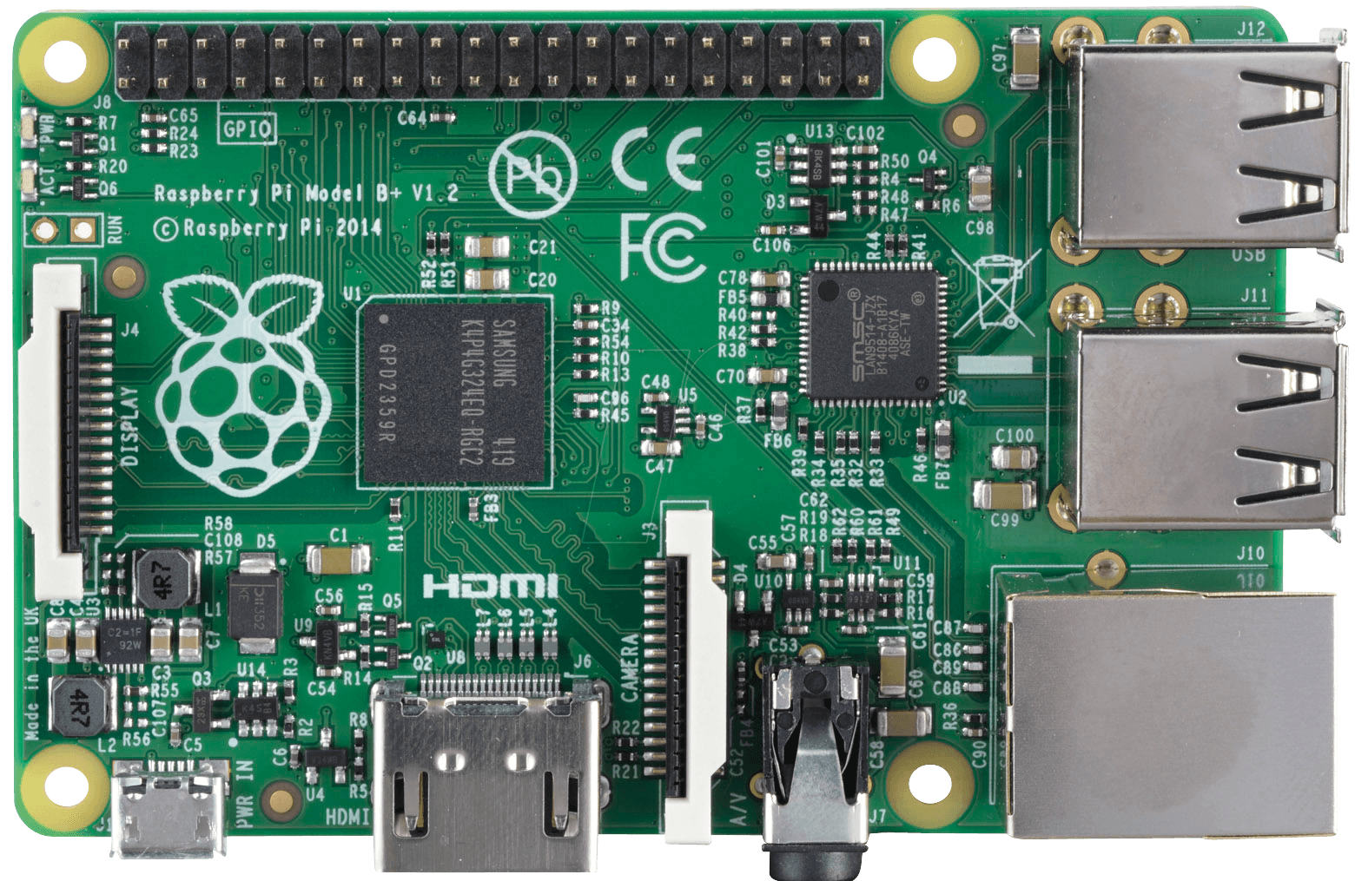
COMPONENT DETAILING
Raspberry Pi 3 :
The Raspberry Pi 3 is a versatile, compact computer that brings powerful computing capabilities to a wide range of applications. Launched in February 2016, it features a 1.2 GHz 64-bit quad-core ARM Cortex-A53 CPU, which provides a significant performance boost over its predecessors. The Raspberry Pi 3 includes 1 GB of RAM and an integrated GPU, the Broadcom VideoCore IV, capable of handling HD video and complex graphics tasks.

Slide 8
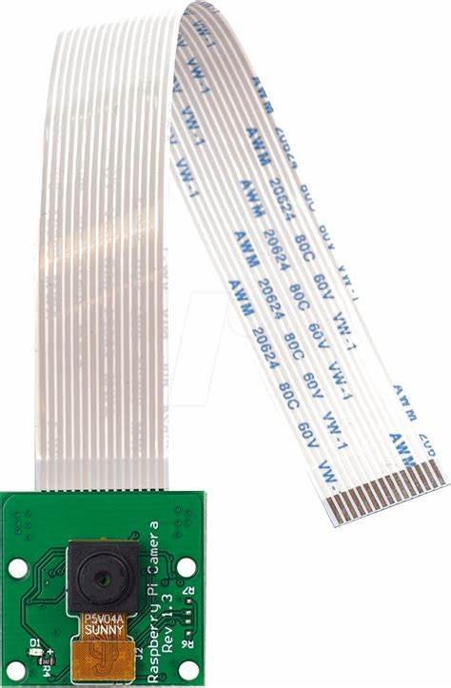
COMPONENT DETAILING
Pi camera module
The 5-megapixel Pi Camera Module is a compact and high-quality camera designed specifically for use with Raspberry Pi devices. This camera module is equipped with the OmniVision OV5647 sensor, capable of capturing still images at a resolution of 2592 x 1944 pixels and recording video at 1080p30, 720p60, and 640x480p90 resolutions. It connects to the Raspberry Pi via the dedicated Camera Serial Interface (CSI) port using a 15cm ribbon cable, ensuring fast data transfer and minimal latency.

Slide 9
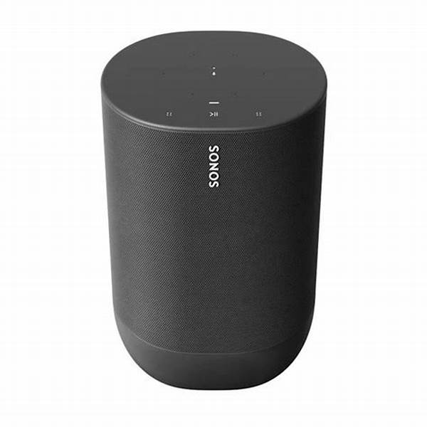
COMPONENT DETAILING
Speaker
The Raspberry Pi Speaker is a versatile and compact audio module designed to deliver clear and powerful sound for various applications. It easily integrates with Raspberry Pi projects, providing high-quality audio output for voice and music. This speaker is ideal for creating custom audio notifications, alarms, or enhancing media playback in your projects. Its small form factor makes it perfect for embedded systems and portable devices.

Slide 10
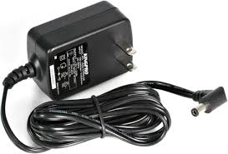
COMPONENT DETAILING
Power supply
Power Supply(5V): A programmable DC power supply is used by engineers to test a component, circuit or electronic device, such as IoT devices, medical products, mobile phones, and remote industrial sensors. The DC power supply allows engineers to set and supply specific voltages to power the device to confirm it's working as intended.

Slide 11
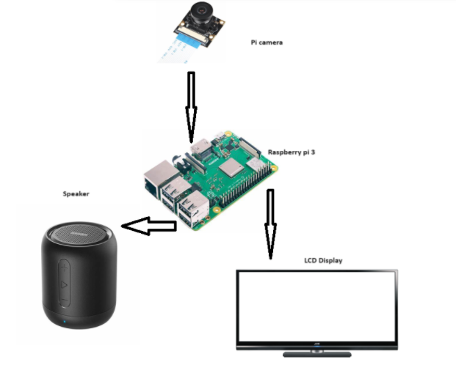
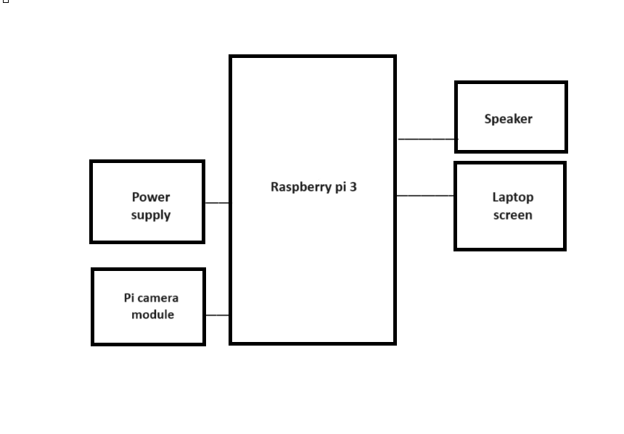
BLOCK DIAGRAM

Slide 12
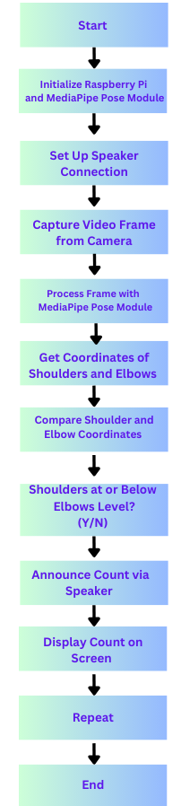
FLOW CHART

Slide 13
PROPOSED MODEL
OPERATION:
Setup: Giving connections to the Raspberry Pi.
Collection: Sending data to the Raspberry Pi.
Processing: Processes the data to accurately count the number of push-ups
Transmission: The processed data is sent to a connected web or mobile app
Display : The app displays real-time push-up counts
Feedback: Users receive feedback, set goals, and can track their progress over time.
Maintenance: Regularly check and update the system

Slide 14
PROPOSED MODEL
ADVANTAGES:
Real-Time Tracking: Provides instant feedback on push-up counts and performance.
Connectivity: Syncs with web or mobile apps for easy access to performance insights.
Motivation: Offers features like goal-setting and progress sharing to boost motivation.
Customizability: you can adjust the sensitivity of the sensors, set different goals, or create specific workout plans.

Slide 15
PROPOSED MODEL
DISADVANTAGES :
Dependency on Technology: Relies on the functionality of electronic components and software.
Maintenance: Regular updates and maintenance of software and hardware might be necessary.
Setup Complexity: Requires careful installation and configuration of sensors and Raspberry Pi.

Slide 16
CONCLUSION
The IoT-based push-up counter leveraging Raspberry Pi demonstrates a successful integration of hardware and software to enhance fitness tracking. By utilizing sensors and the Raspberry Pi, the system accurately counts push-ups in real-time, offering users valuable feedback on their workout performance. The project's implementation showcases the potential of IoT technology in personal fitness applications.

Slide 17
REFERENCES
A. Muzakir and C. D. Kusmindari, "Push-Up Detector Applications Using Quality Function Development and Anthropometry for Movement Error Detection", Scientific Journal of Informatics, vol. 5, pp. 248-257, 2018.
https://www.youtube.com/watch?v=RLQWon4Zmao
https://www.ijset.in/wp-content/uploads/IJSET_V12_issue1_535.pdf
https://aryanvij02.medium.com/push-ups-with-python-mediapipe-open-a544bd9b4351

Slide 18
THANK YOU

